Slide 1
Should we consider Magist for our expansion in Brazil?

Slide 2
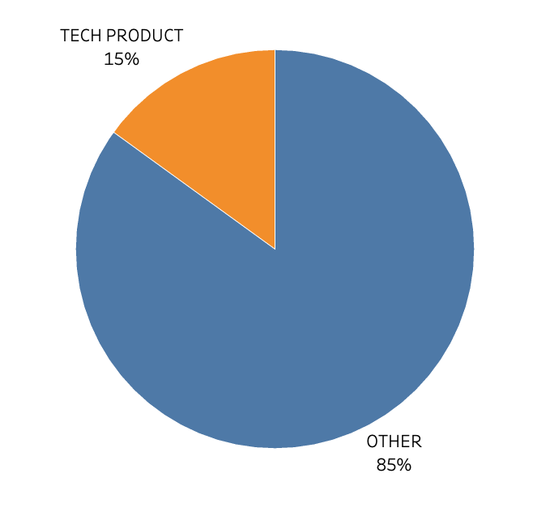

Magist Tech products percentage share

Slide 3
€120.65
is the average price
of the products being sold on Magist
Average item price of Eniac : €540

Slide 4
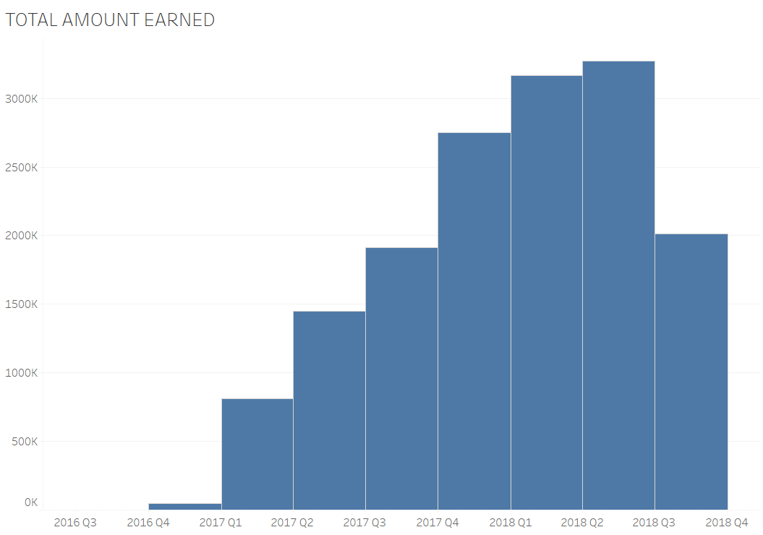
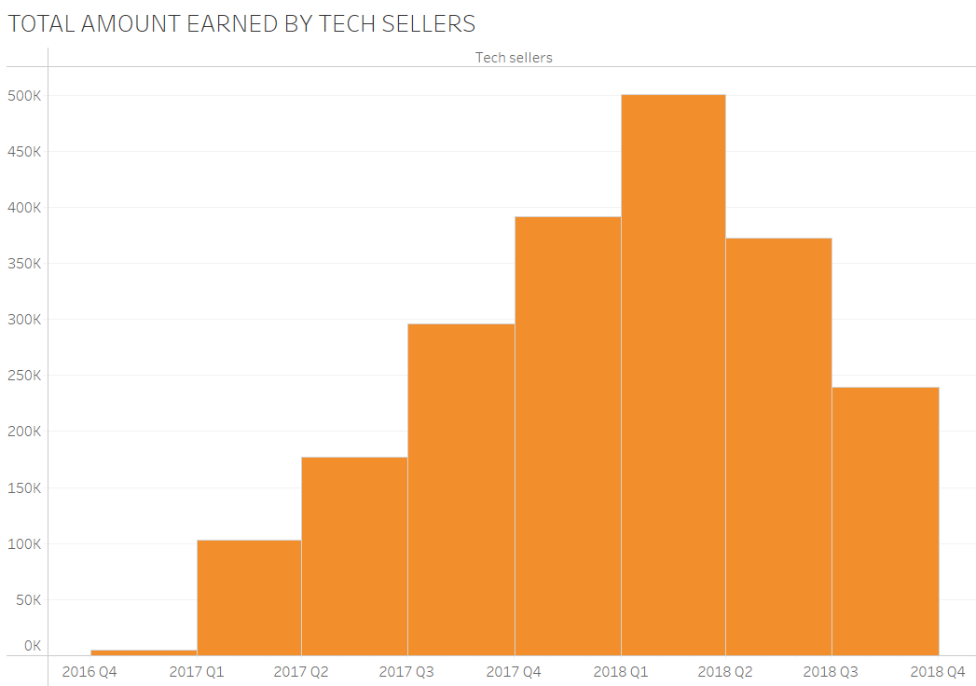
AVG PER MONTH = €701.021
AVG PER MONTH = €99.339

Slide 5
The average monthly revenue for Tech Sellers is only the 8.5% of Eniac’s

Slide 6
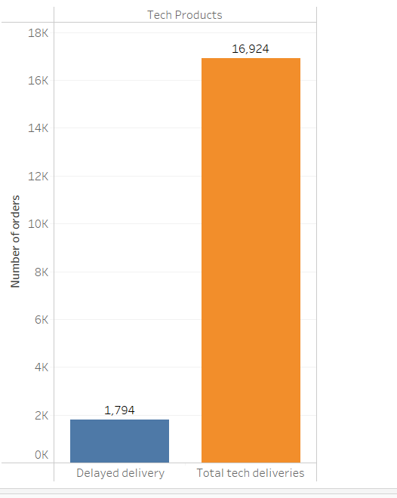
The Average delivery time of Magist exceeds the market delivery days.
Late deliveries represent 11% of all deliveries.

Slide 7
Conclusion
Based on the following reasons, we recommend against using Magist as our platform:
Magist has a minimal market share in tech products sector.
Despite the company’s growth, there are still areas of concern.
Unreliable delivery services can result in reputational damage and potential revenue loss.
Please feel free to ask if you require any additional information.

Slide 8
APPENDIX

Slide 9
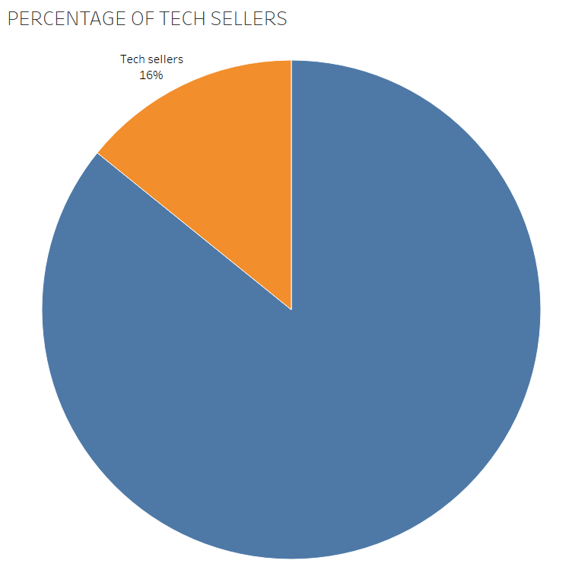
Total Sellers = 3095
Tech sellers = 484

Slide 10
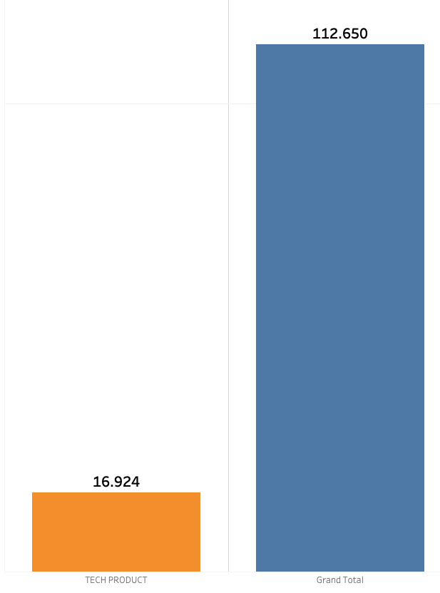

Slide 11
